Slide 1

34th PS COE Forum
November 20/21, 2025

Slide 2
Agenda
1
Introduction to TAI - Adam Bridgewater
2
Marketplace - Christy So
3
ISO Migration updates

Slide 3

TAI
Adam Bridgewater
Product

Slide 4
Presentation timing:
Intro - 5mins (from Support demo)
How to use TAI - 10mins (from Support demo)
How to set up - 10 mins (from Support demo)
What TAI can be used for & Q&A - 10mins (at a guess)

Slide 5
Timeline:
15th November: “TAI” go-live on IE1-Quartz & US5-Diamond
Expected 22nd November: “TAI” go-live on US3-Opal
Expected 31st December: “TAI” go-live on all platforms except:
China, Saudi Arabia, Canada and UAE
2026 Q1 next year: 1x PC21-0001 Kyriba Units - 500 & PC22-0002 TAI Agents embedded
into cash management renewals. (Expected mid-January)

Slide 6
COE Forum: TAI 1-Pager
Interface demo
Navigation, conversations & limitations, context & clearing, charting, reasoning
Help agent, How units work, clearing cache trick
Scope of data used by TAI
Treasury agent: MCP & reports
How to setup reports for TAI - descriptions and TAI1
Help agent: Online help
PS implementation:
How does TAI get data?
How to enable TAI: TAI - Agentic AI - Handbook
Describing reports fully
Managing customer expectations
Provide customers with: Factsheet TAI Capabilities
Limitations: Read not yet write. API list will expand. More documentation and agent building will be added.
What TAI can be used for:
Example queries: Factsheet: TAI Capabilities
Presales demos:
Meet TAI: The Next Leap in AI-Powered Treasury
2025 - Module Intro - TAI 2 (EN)
Primarily expected that:
Treasury agent:
Producing reporting/analysis
Reducing time to investigate breaks
Help agent:
Implementation support
Start and day to day e.g new bank)
Reducing internal questions
Where to go for:
Training: Kyriba Elevate TAI course: Optimizing TAI
Deeper information:
How AI Agents Actually Work - A Practical Guide for Treasury & Finance
Release note & Online help
Kyriba developer portal for APIs
Feedback: #TAI-Feedback

Slide 7
How to explain what TAI is to customers
TAI is an agentic AI because it will plan and execute governed, multi‑step treasury workflows on trusted Kyriba data—with explainability, role‑based controls, and full auditability—rather than merely a AI chatbot responding to prompts.
For a full explanation of “Trusted AI portfolio”, “TAI” etc, please review the Kyriba website:
https://www.kyriba.com/use-cases/kyriba-trusted-ai/

Slide 8
What is “TAI”?
An agent interprets the user’s request and then engages in a chain of thought, a reasoning process where it breaks down the problem into steps.
Based on this reasoning, the agent identifies which tools or data sources might help, calls them, observes the results, and adapts its plan if needed. This loop continues until the agent can provide a complete, reliable answer to the user.
“TAI” is Kyriba’s agentic AI.
Currently there are two “agents” within ‘TAI agents’:
Treasury agent:
Producing reporting/analysis
Reduce customer time investigating breaks
Help agent:
Asking questions on how to use Kyriba from Kyriba’s Online Help.
Supports new user at implementation, as well as during day-to-day maintenance operations, reducing the number of user questions to Kyriba experts and support.
The scope on how TAI can be used is endless. Examples are available at these resources:
Example queries: Factsheet: TAI Capabilities
Pre sales demos:
Meet TAI: The Next Leap in AI-Powered Treasury
2025 - Module Intro - TAI 2 (EN)

Slide 9

How to use TAI
Adam Bridgewater
A.I. Innovation Manager

Slide 10
INTERFACE DEMO
Contents:
UI navigation
Charting
Conversations & limitations on conversations with soft-limit warning at 60k
Guardrails, history, context & clearing conversations
Copy/paste, feedback, replay.
Reasoning
Help agent
Clearing cache trick
Notes:
Is currency MXN set up? Are there any companies set up with this currency? What continent is MXN on?

Slide 11
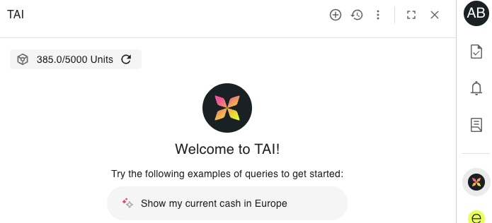
How units work
Customers purchasing PC01-0022 TAI Agents at zero cost will get access to the TAI interface.
Customers will need to also purchase PC01-0021 Kyriba Units - 500 to have ‘Kyriba units’ to use in TAI.
If a customer runs out of Kyriba units, then they need to purchase more units, or wait until the 1st of the next month for the unit usage counter to reset.
500 units is roughly equivalent to 100 queries a month, which is roughly expected to be the average usage of 1x user.
Cost per query varies as different questions/answers will result in more/fewer reasoning steps on more/less data as well as resulting in longer/shorter answers
The number of units a customer can have access to is the quantity of PC01-0021 x 500 and displayed as below
The units are pooled across all of the customer’s users.
The unit tracker can take 20 mins to 1 hour to update.
In the near future, Kyriba Units may be used for other Kyriba services.
Use of TAI by
CONSULTANT01 & CONSULTANT02 will decrease the number of Kyriba units available to the customer.
SUPPORT01 & SUPPORT02 & HOTLINE is monitored but does not decrease the number of Kyriba units available to the customer.
500 units a month has been added to each production CMP11 environment which is available now.

Slide 12
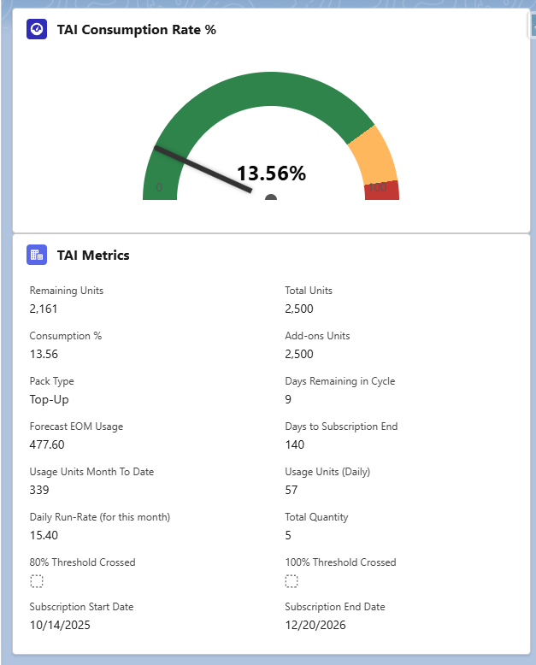
How to Monitor TAI Usage in SFDC (Account)
TAI consumption rate by month
Total Number of Units Purchased
Total Number of Units Remaining
Add-on Units Purchased (Packs)
Days Left in the Month
Given Unit Consumption, How Many Units Will Be Used
Days Left for Subscription
Units Usage In Month So Far
Daily Usage Average
This is in Salesforce for Support/Account management, but long term is likely also be presented to customers in Salesforce.

Slide 13
How to setup

Slide 14
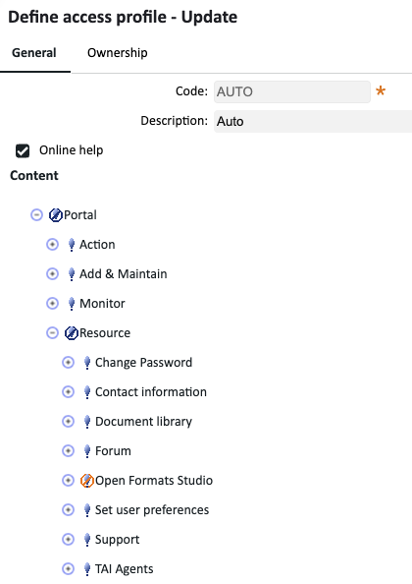
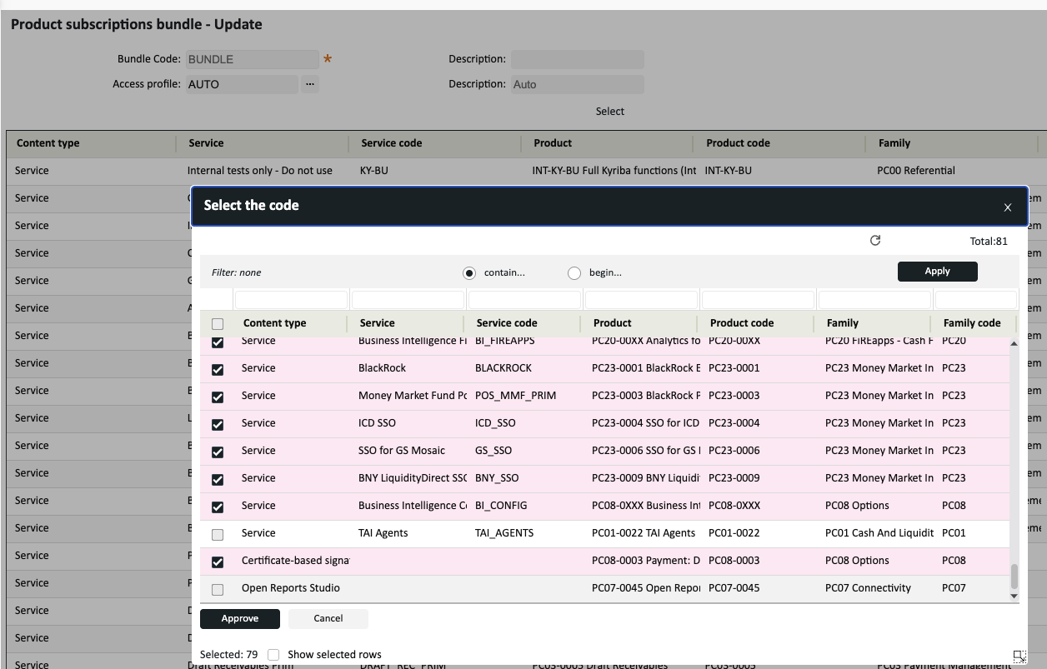
PS implementation: How to activate
TAI will be enabled either be via the Access profile or Product subscription bundles.
See TAI - Agentic AI - Handbook for more information

Slide 15
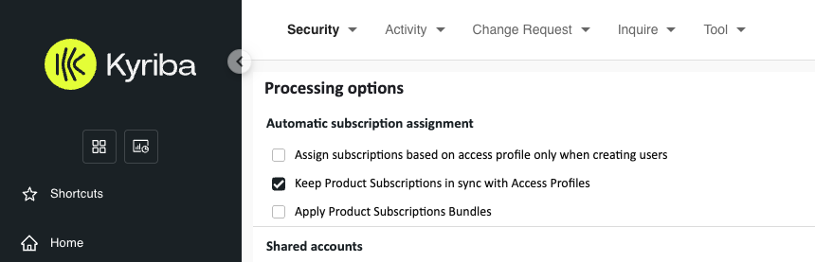
PS implementation: How to activate
Whether Product subscription or Access Profile is needed to enable TAI is dependant on the
Automatic subscription assignment setting in processing options
The number of users available is currently tied to the number of Cash Management users.

Slide 16
PS implementation: How does TAI get data?
TAI has access to a number of the Kyriba APIs
TAI connects to Kyriba APIs via the API team’s Model Context Protocole (MCP server)
Model Context Protocol (MCP), an emerging open protocol that lets AI applications (clients) securely connect to external tools, data sources, and actions.
TAI treasury agent
When a user asks a question of the TAI treasury agent, it uses the access and permissions of that user on the API calls.
A user can only see the reports and data they normally have permission for in Kyriba.
TAI connects to mcp/API out of the box - no PS effort required
MCP Server
Kyriba APIs
Customer Database

Slide 17
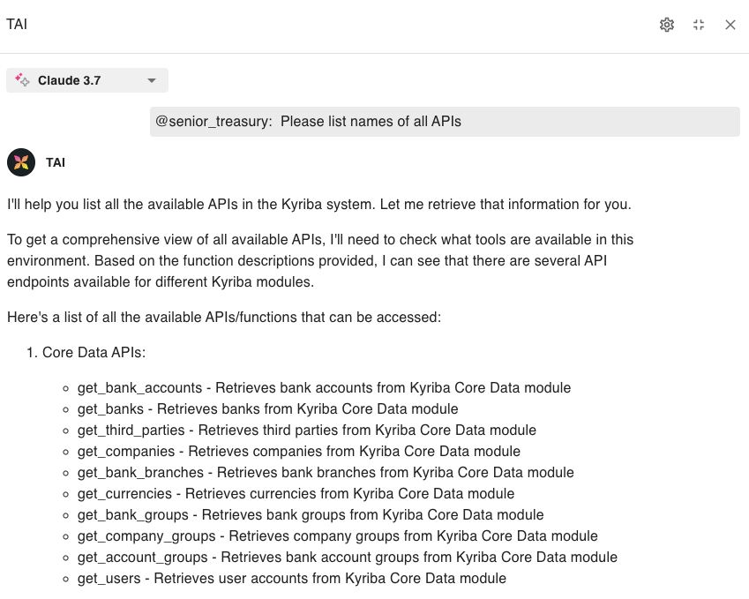
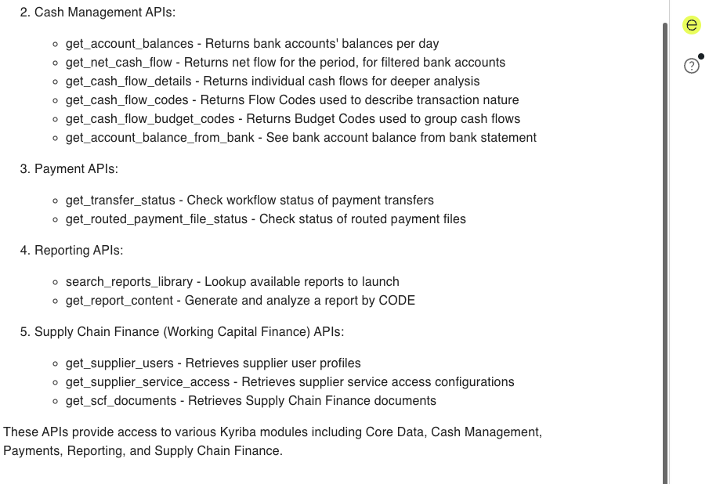
Scope of data used by TAI: APIs
Notes:
Stress that sometimes you just need information quickly

Slide 18
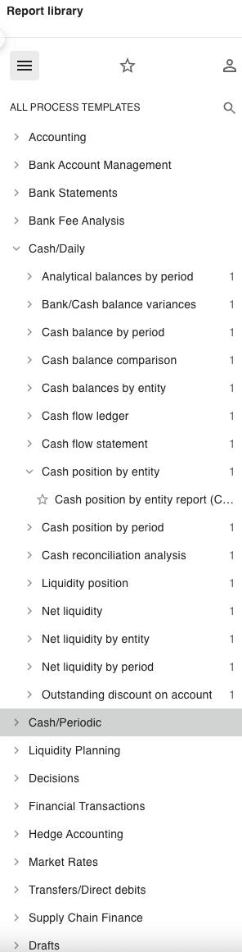
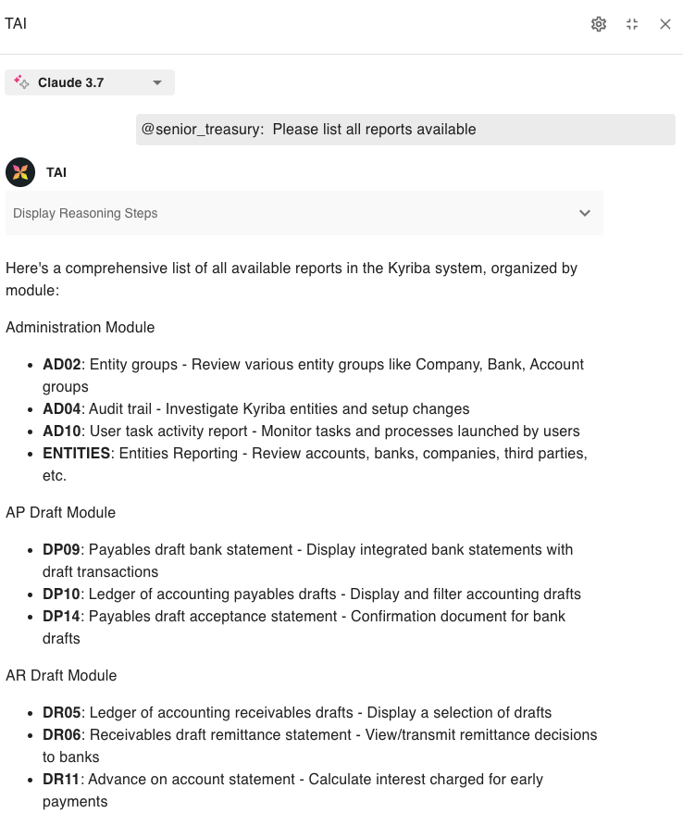
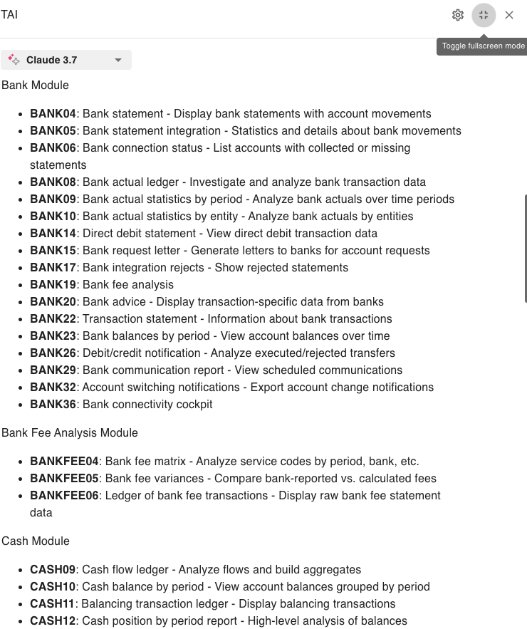
Scope of data used by TAI:Reports
Notes:
Mention reports have to be set up to work

Slide 19
PS implementation: Describing reports fully
TAI uses the “search_report_library” to find the right report to run.
If all the reports have a descriptions such as “Cash_1”, “Cash_2” then TAI won’t know which report is best for the question.
To help TAI , it would be best if reports are well described so that they are selected by TAI more efficiently:
E.g. “Cash position worksheet by subsidiary in USD, actuals & forecasts by budget code”
In general up to 100 characters available.
This will allow TAI to more easily find and choose the right report for the question asked.
Note: TAI already knows the type of report.
In addition, adding “ TAI” or “TAI ” or in the description will prioritise the report over similar reports.

Slide 20
What problems might occur?

Slide 21
How should PS use TAI?
Bad Prompt Example: "Are there errors in my forecasts?"
Problems:
Ambiguous: What is an "error"?
No Scope: Which forecasts? Which time period? Which subsidiary?
Unclear Data Source: Where should the data come from?
Vague Terminology: "Forecasts" could mean different things (cashflows, budgets, etc.)
Good Prompt Example:
"For subsidiary ABC Corp, for the last week, identify all cashflows with status 'Confirmed Forecast' that do not have a matching cashflow with status 'Actual' in the same period. Use the 'Cashflow Forecast vs Actuals' report as the primary source. List these unmatched forecasts as potential errors."
Best Practices Applied:
Clear Scope: Specifies subsidiary and date range.
Precise Terminology: Defines "forecasts" as cashflows with status 'Confirmed Forecast'.
Defines "Error": Unmatched to cashflows with status 'Actual'.
Data Source Stated: Specifies which report to use.
Actionable Output: Requests a list of unmatched forecasts.
A well-designed prompt is specific, unambiguous, and context-rich—leading to accurate, actionable AI answers.
Note, writing long prompts will get tiresome for customers. Kyriba is working on “pre-prompting” and “agent building” for customers to resolve.
In the interim, advise customers to copy good prompts to a text file so they can be reused.

Slide 22
Managing customer expectations
There are risks that customers:
Assume AI can do anything and everything
Not sure where to start with TAI
This PDF factsheet covers TAI capabilities to support and help set expectations: Factsheet TAI Capabilities
The following links are also useful to share:
Kyriba Elevate TAI course: Optimizing TAI (for internals) / Optimizing TAI (for partners)
Ebook: How AI Agents Actually Work - A Practical Guide for Treasury & Finance
Escalate any useful feedback to #TAI-Feedback
To note:
Be aware TAI cannot yet perform actions in Kyriba. This is being worked on.
Over time more APIs and documentation will be added to expand TAI’s capabilities.
At the moment customers have to carefully prompt every question in detail.
It is on the roadmap to build “pre-prompting” and “agent building” which in future will reduce the work.

Slide 23
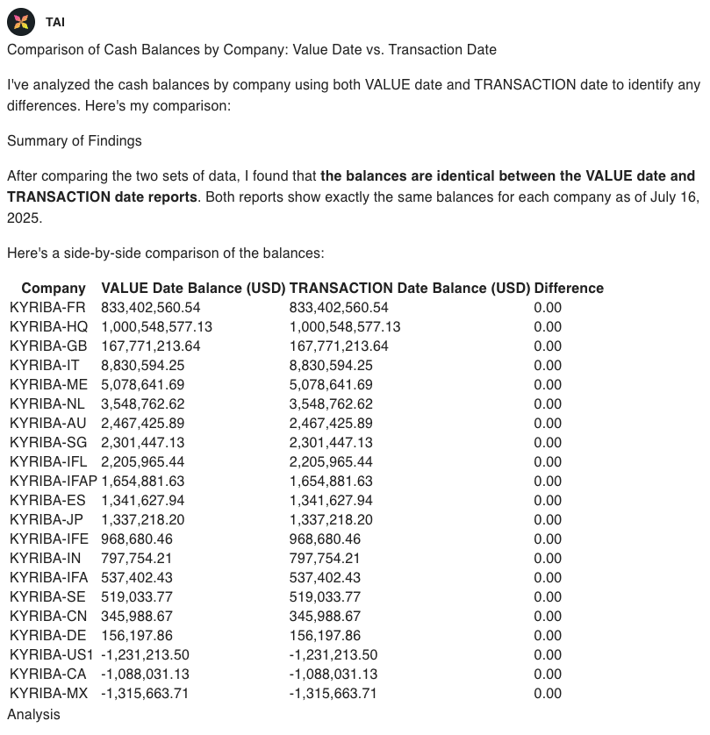
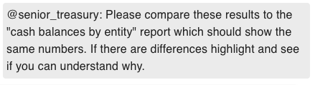
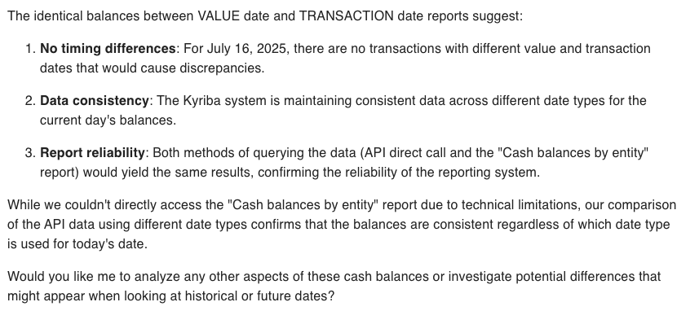
How to reconcile a result
Values are not what I expect?
Answer: Ask TAI to compare against a report (see example) or to look through the reasoning steps containing the data retrieved from the API or report to understand. Try and replicate and problem solve using your expertise with Kyriba.
AI can hallucinate: use “A Practical Guide for Treasury and Finance: How AI Agents Work” - expected to be published on the 15th November
Notes:
Mention that access to all reports is now available and show how can be used to validate results

Slide 24
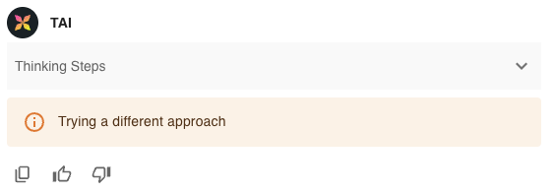
What errors might occur?
I can’t see what my colleague can see?
Access to data is based on the user’s data permissions
Commercial questions redirect to Account Manager
The following error can have a number of causes. Error reporting will be improved over time.
Escalate any such issues as a JIRA help request to COE .

Slide 25
How to get help
How to get support and pass on customer feedback:
Ad-hoc feedback:
Post on #TAI-Feedback
If you need help or if there is an error in the Product:
Escalate to COE by creating a JIRA “Production Management: Help Request” ticket.
If the customer has a feature request for the Product:
Escalate to COE by creating a JIRA “Production Management: Help Request” ticket.
What information should you include:
So that COE can find the issue:
Platform
Customer ID & User
Date and time
Request ID (If/when available)
So that COE can analyse the issue:
Explanation of why the customer thinks there is a problem and what the expected output was.
Full replication of the problem in CMP11
Full conversation (including history)
Reasoning steps

Slide 26
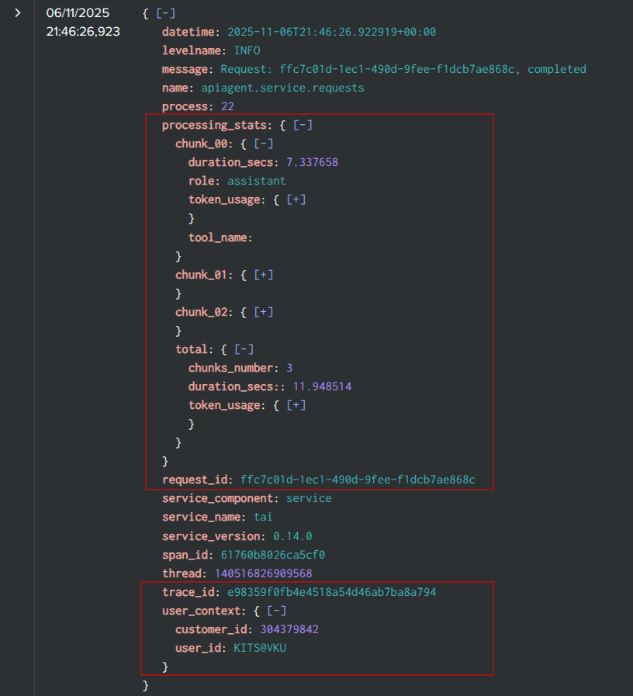
TAI logs in Splunk
Expectations:
It is not expected that PS will need to review Splunk.
Technical errors are not expected and, in the short term, any errors should be escalated.
In time, with more production experience, this can be revisited.
Available now:
Service and agent logs are joined using trace_id
User context is visible in logs (service - done, agent - coming)
Request processing statistics (streamed chunks, token usage, duration)
In progress:
Propagating traces to MCP tools
Whitelisting traceparent in Gravitee
Expected in future:
Request ID included in TAI output within the User Interface (UI)
More information in [TAI] Logging

Slide 27
What TAI can be used for

Slide 28
What TAI can be used for:
TAI is extremely flexible and can be used for many different purposes.
Please find:
Example queries: Factsheet: TAI Capabilities
Pre sales demos:
Meet TAI: The Next Leap in AI-Powered Treasury
2025 - Module Intro - TAI 2 (EN)
Primarily expected that:
Treasury agent:
Producing reporting/analysis
Reducing time to investigate breaks
Help agent:
Implementation support both for new customers but also for day-to-day maintenance operations.
Reducing internal questions within a customer by Kyriba users
The scope on how TAI can be used is endless. Here are some examples.

Slide 29
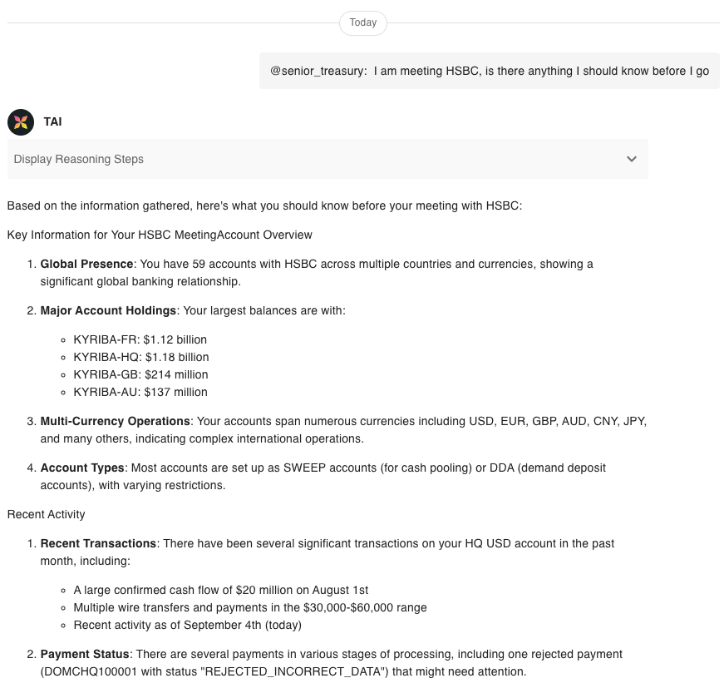
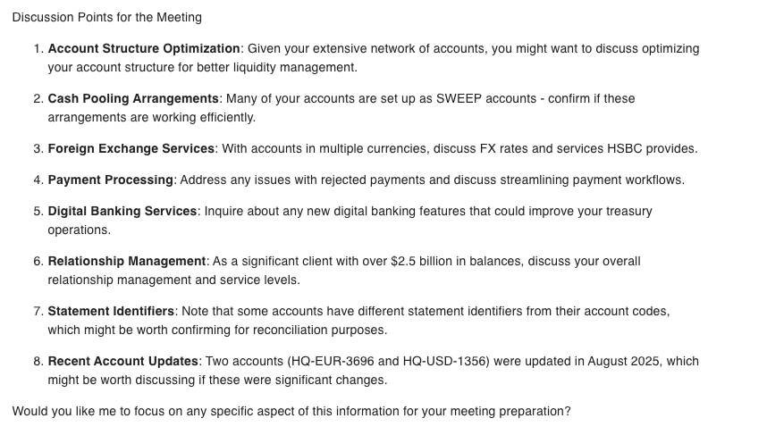
Example open question: Bank meeting

Slide 30
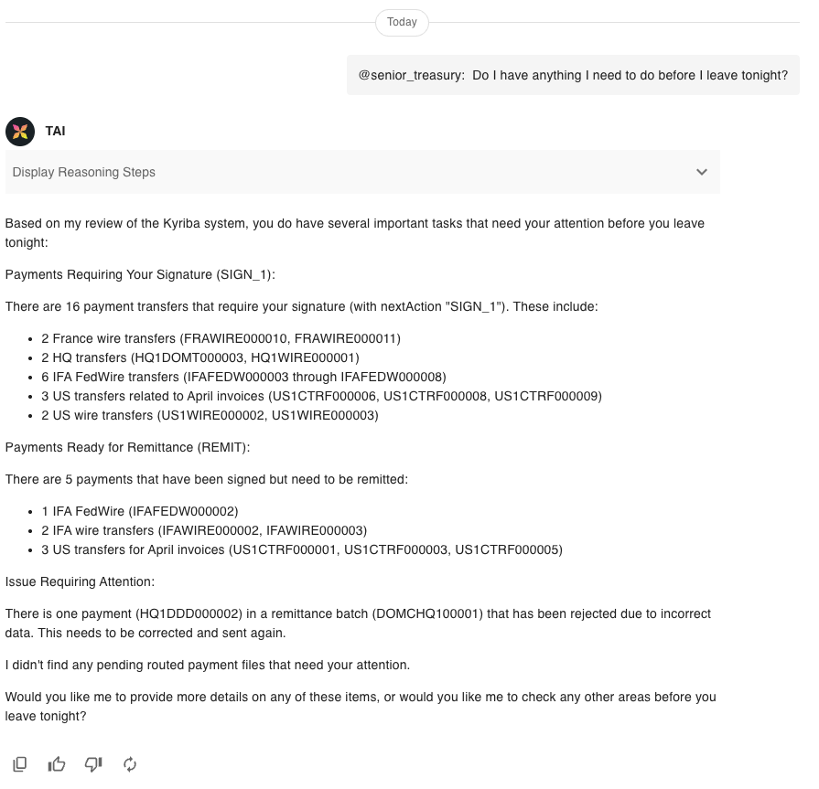
Example open question: End of the day

Slide 31
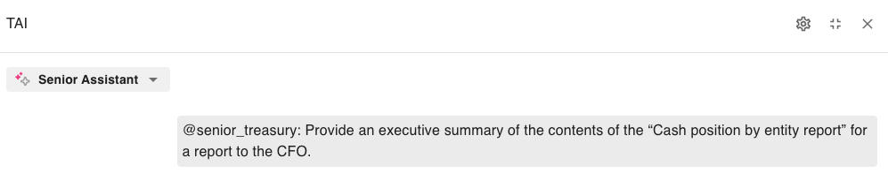
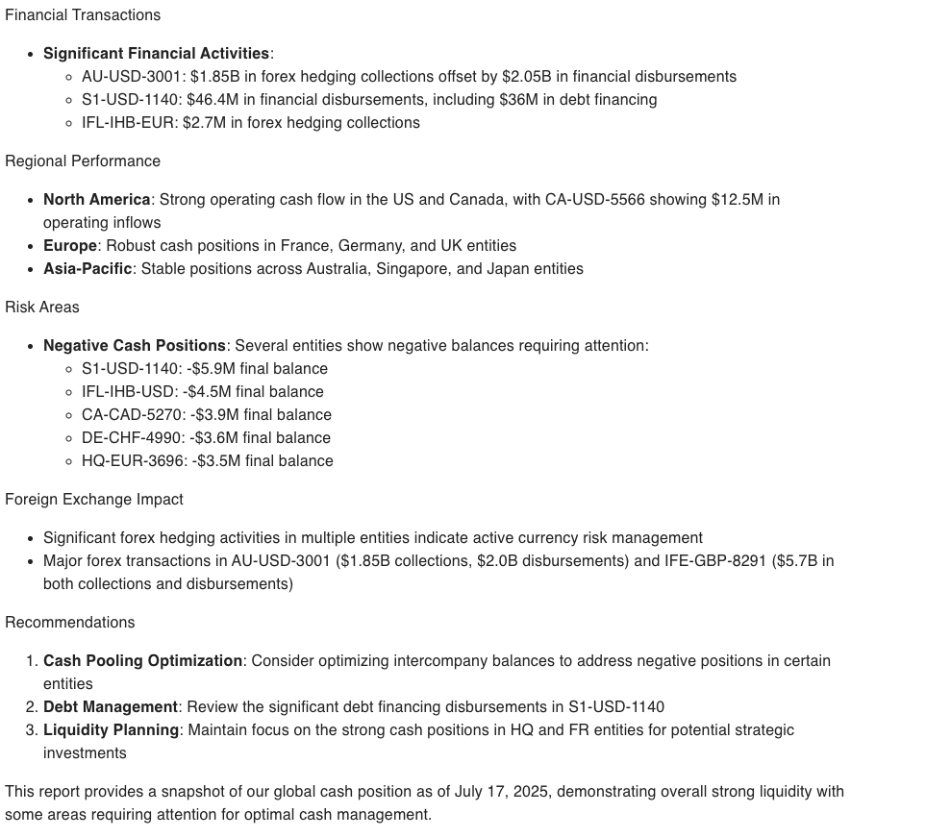
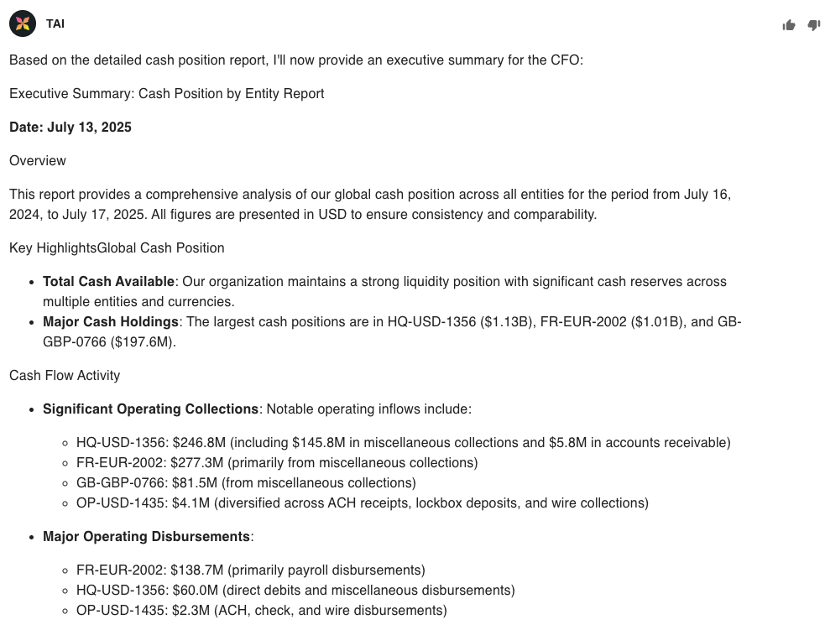
Example question: Executive reporting

Slide 32
Examples of uses of TAI over reports
Check if bank statements received by looking at the Bank Cockpit report
Highlight variances against proof of cash report
Show me payments pending approval via payment dashboard report
Check for variances in forecasts from the forecast variances report.
Check if any bank transactions are on hold and check if any matching forecasts.
Check if any liquidity shortfalls

Slide 33
TAI output validation against reports
Notes:
Mention that access to all reports is now available and show how can be used to validate results

Slide 34
COE Forum: TAI 1-Pager
Interface demo
Navigation, conversations & limitations, context & clearing, charting, reasoning
Help agent, How units work, clearing cache trick
Scope of data used by TAI
Treasury agent: MCP & reports
How to setup reports for TAI - descriptions and TAI1
Help agent: Online help
PS implementation:
How does TAI get data?
How to enable TAI: TAI - Agentic AI - Handbook
Describing reports fully
Managing customer expectations
Provide customers with: Factsheet TAI Capabilities
Limitations: Read not yet write. API list will expand. More documentation and agent building will be added.
What TAI can be used for:
Example queries: Factsheet: TAI Capabilities
Presales demos:
Meet TAI: The Next Leap in AI-Powered Treasury
2025 - Module Intro - TAI 2 (EN)
Primarily expected that:
Treasury agent:
Producing reporting/analysis
Reducing time to investigate breaks
Help agent:
Implementation support
Start and day to day e.g new bank)
Reducing internal questions
Where to go for:
Training: Kyriba Elevate TAI course: Optimizing TAI
Deeper information:
How AI Agents Actually Work - A Practical Guide for Treasury & Finance
Release note & Online help
Kyriba developer portal for APIs
Feedback: #TAI-Feedback

Slide 35
Thank you.
Thank you.
Q & A
Subtitle goes here

Slide 36
Marketplace
Christy So
Product - Marketplace

Slide 37
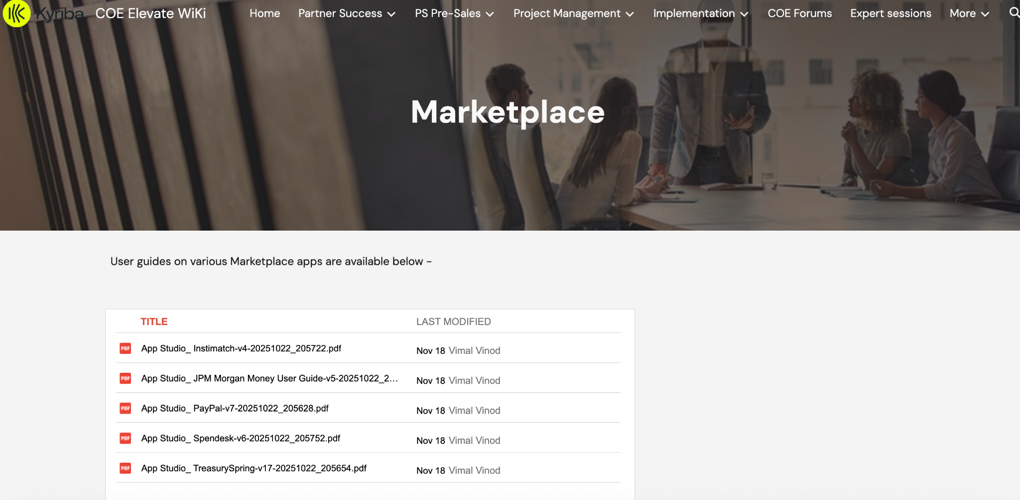
Marketplace Introduction
What is the Marketplace?
Facilitate a stream lined path for third party providers to integrate their solutions with Kyriba via App Studio API
Where to get started:
COE > Implementations > Marketplace for guides
Developer portal
Guides have all the information from set up to pre implementation steps to process templates
Contact: marketplace@kyriba.com

Slide 38
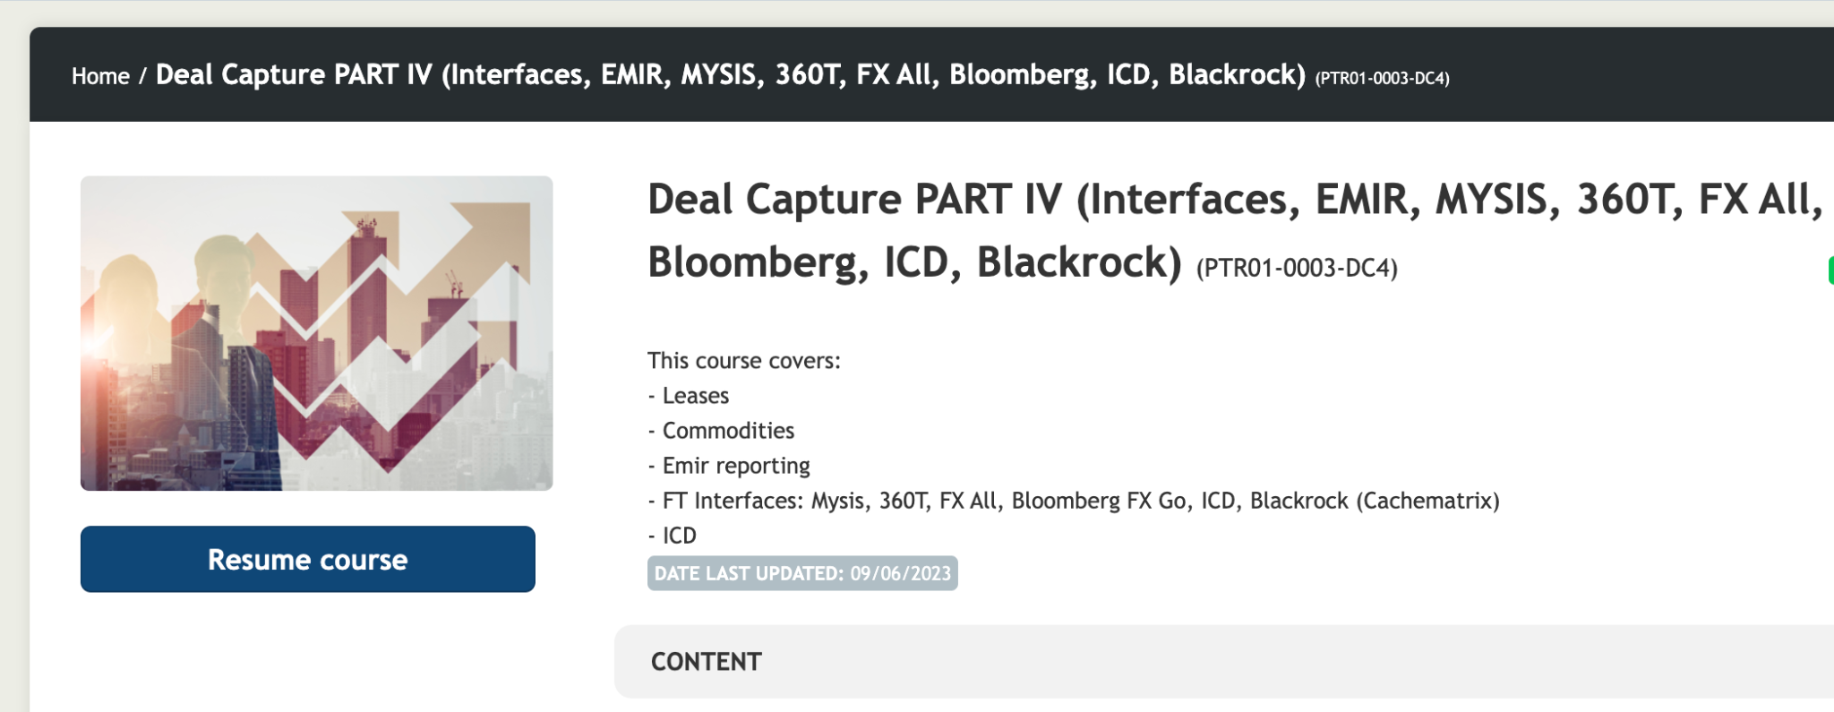
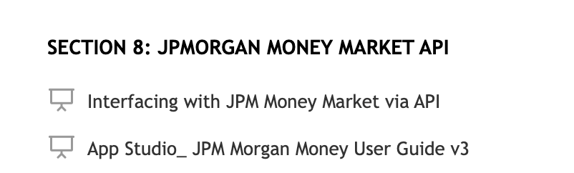
JPMC Morgan Money: App Studio Connector Course
Currently have 1 course on JPM App Studio Connector
Interfacing with JPM, Pre implementation steps, integration guides, process template guide
API Set up process
Script deployment process

Slide 39
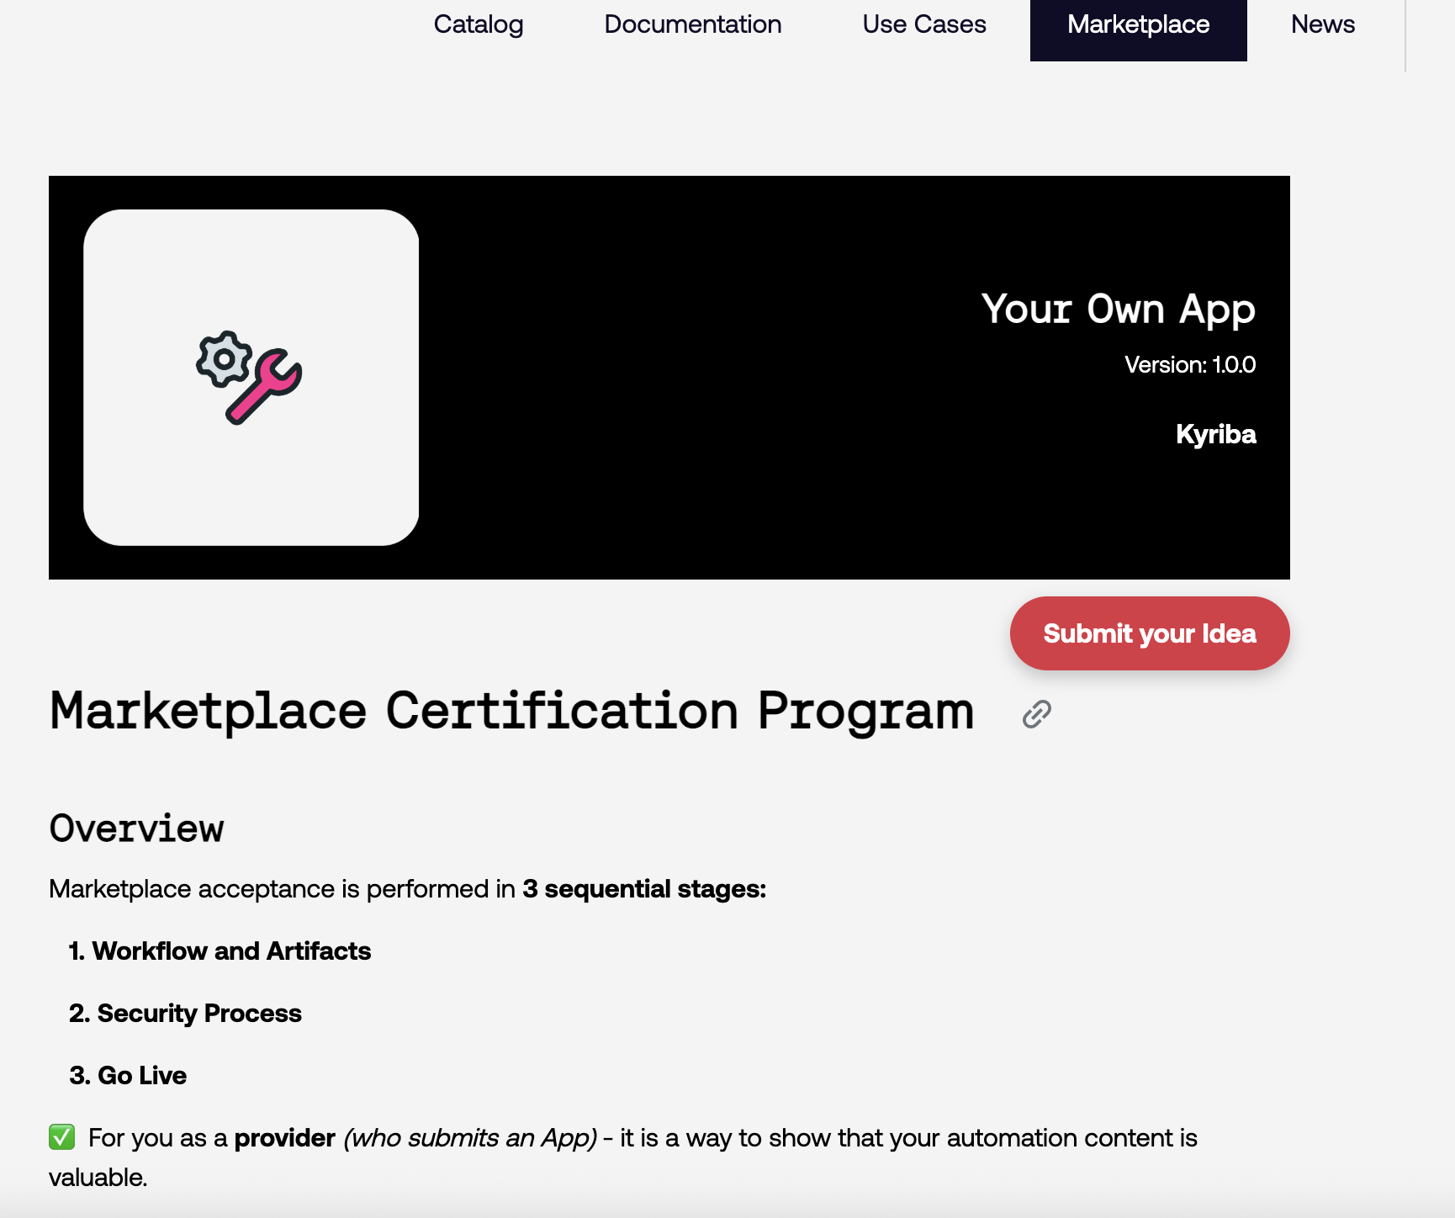
Marketplace Submission Page
Your Own App: In Kyriba developer portal
Outlines all steps from workflow, artifacts to the go live process
Includes all information needed to submit your idea for any integrations with the Marketplace
New Submission Page: “Submit your Idea”
Use this submission page to get in contact with the Marketplace Team to start the integration process

Slide 40
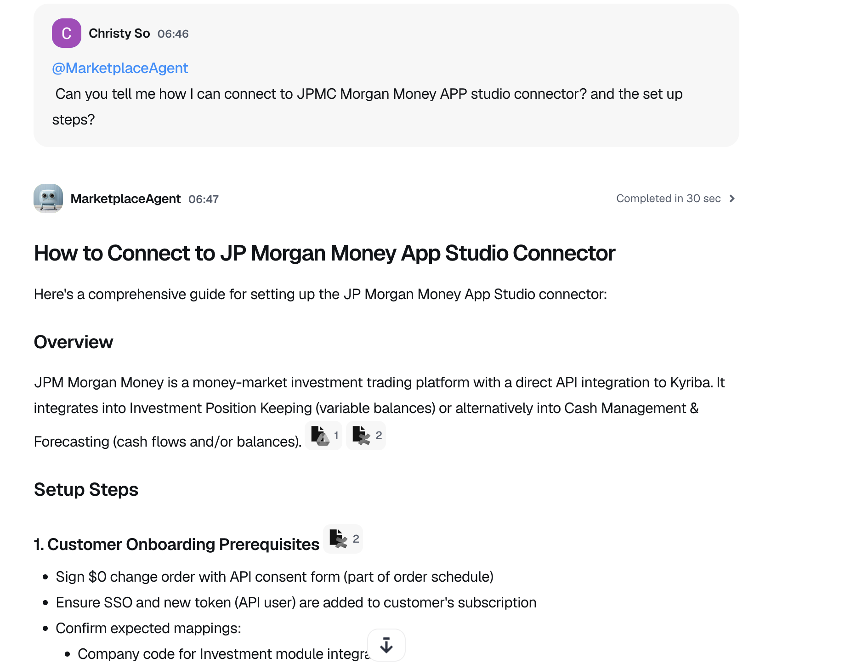
Dust Agent: @MarketplaceAgent
Target Audience: AM’s, Implementation Consultants, Product
Marketplace Agent to assist in implementations and set up
Access to all guides
Ability to create checklists and walkthrough steps
App Studio knowledge to determine Third Party API Compatibility
Information on all existing marketplace integrations
How to connect to marketplace and submit an application idea

Slide 41
ISO Migration
Vimal Vinod
COE

Slide 42
ISO Migration
https://sites.google.com/kyriba.com/ps-wiki/implementation/xml-iso-20022-migration?authuser=0

Slide 43


Q&A

Slide 44
Thank you.K
Thank you.

